Slide 1
Computer network session 12
CLOUD SECURITY CONCEPTS
Santoso Budijono

Slide 2
Learning outcomes
LO 1: Describe basic structures of network
LO 2: Explain basic concepts of network

Slide 3
topics
Cloud Shared Responsibility Model
Load Balancing
Auto Scaling

Slide 4
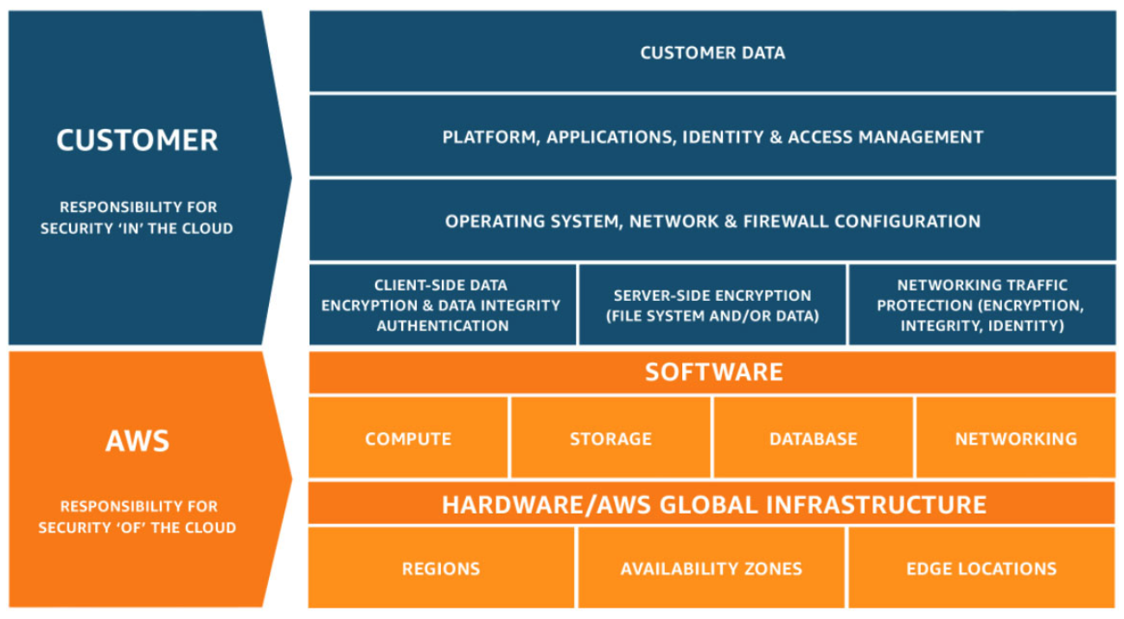
Cloud security
Aws shared responsibility model

Slide 5




cloud
Security of the cloud
AWS responsibilities:
Physical security of data centers
  Controlled, need-based access
Hardware and software infrastructure
  Storage decommissioning, host operating system (OS) access logging, and auditing
Network infrastructure
  Intrusion detection
Virtualization infrastructure
  Instance isolation
AWS services
Compute
Storage
Database
Networking

Slide 6
cloud
Customer responsibility
Customer responsibilities:
Amazon Elastic Compute Cloud (Amazon EC2) instance operating system
  Including patching, maintenance
Applications
  Passwords, role-based access, etc.
Security group configuration
OS or host-based firewalls
  Including intrusion detection or prevention systems
Network configurations
Account management
  Login and permission settings for each user
Customer data
Applications, IAM
Operating system, network, and firewall configuration
Client-side data
encryption and data integrity authentication
Server-side encryption
(file system or data)
Network traffic protection
(encryption, integrity, identity)
Customer-configurable

Slide 7






cloud
Service characteristics and security responsibility
Example services managed by the customer
Infrastructure as a service (IaaS)
Customer has more flexibility over configuring networking and storage settings
Customer is responsible for managing more aspects of the security
Customer configures the access controls
Platform as a service (PaaS)
Customer does not need to manage the underlying infrastructure
AWS handles the operating system, database patching, firewall configuration, and disaster recovery
Customer can focus on managing code or data
Amazon
EC2
Amazon Elastic Block Store (Amazon EBS)
Amazon
Virtual Private Cloud
(Amazon VPC)
Example services managed by AWS
AWS
Lambda
Amazon
Relational Database Service (Amazon RDS)
AWS Elastic Beanstalk

Slide 8
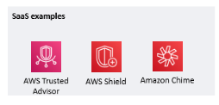
CLOUD
Service characteristics and security responsibility
Software as a service (SaaS)
Software is centrally hosted
Licensed on a subscription model or pay-as-you-go basis.
Services are typically accessed via web browser, mobile app, or application programming interface (API)
Customers do not need to manage the infrastructure that supports the service

Slide 9
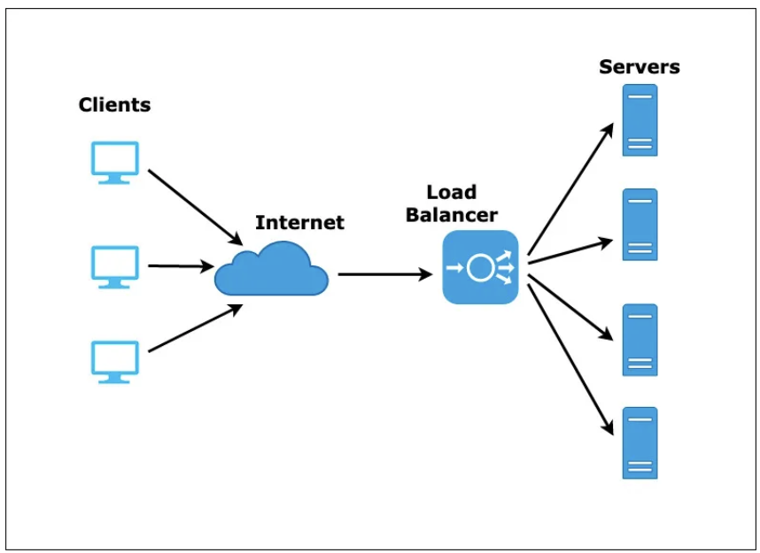
CLOUD
LOAD BALANCING
Company website or applications typically must be on for 24 hours.
To keep this website or application reliable, one of technique is use load balancing
Load balancing is a way to distribute the load that is incoming across multiple devices, thereby making the resource available to more people than having a single server in place
https://codeburst.io/load-balancers-an-analogy-cc64d9430db0

Slide 10
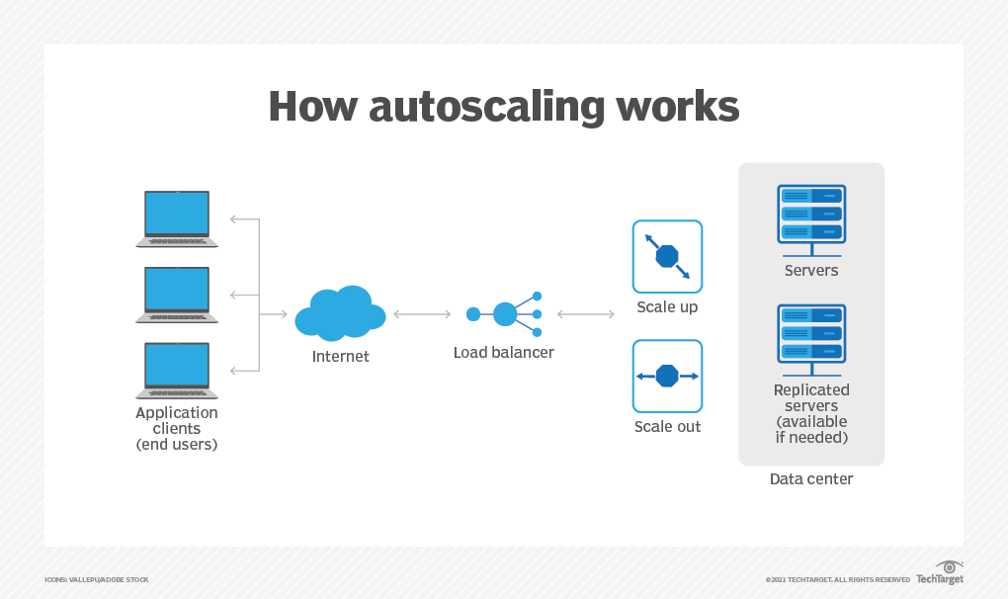
CLOUD
AUTO SCALLING
Autoscaling provides users with an automated approach to increase or decrease the compute, memory or networking resources they have allocated, as traffic spikes and use patterns demand
Autoscaling is a critical aspect of modern cloud computing deployments. The core idea behind cloud computing is to enable users to only pay for what they need, which is achieved in part with elastic resources -- applications and infrastructure that can be called on as needed to meet demand.
https://www.techtarget.com/searchcloudcomputing/definition/autoscaling#:~:text=Autoscaling%20enables%20resources%20to%20scale,a%20scalable%20or%20efficient%20approach.

Slide 11
exercise
What component that must be have for create high availability systems ?

Slide 12
REFFERENCE
Forouzan, B. A. (2021). Data Communications and Networking with TCP/IP Protocol Suite. 6th Ed. New York: McGraw-Hill. ISBN: 978-1-26-436335-3.
https://www.professormesser.com/security-plus/sy0-601/sy0-601-video/load-balancing-sy0-601-comptia-security-3-3/
https://www.techtarget.com/searchcloudcomputing/definition/autoscaling#:~:text=Autoscaling%20enables%20resources%20to%20scale,a%20scalable%20or%20efficient%20approach

Slide 13
Thank you
December 2024

